Slide 1



Project Management

Slide 2

Definitions/Acronyms:
Term/Acronym | Definition
A-SPICE | Automotive Software Process Improvement and Capability Determination
SYS | System Engineering
SWE | Software Engineering
Workflow | Definition, execution and automation of business processes where tasks, information or documents are passed from one participant to another for action, according to a set of procedural rules.
Trace | Link between two meaningful contents in a document

Slide 3
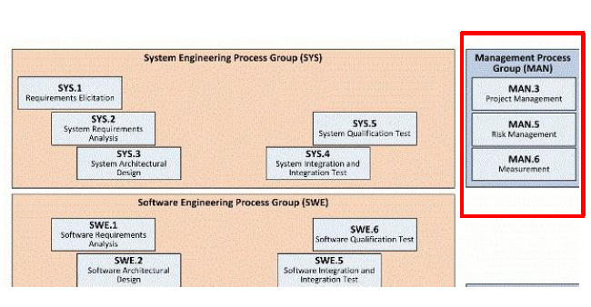
A-SPICE MODEL OF REQUIREMENT DOCUMENT
  Project Requirements Documents are separated into different levels within Integrity on the basis of ASPICE Model.
  Management Process Group covers Project Management, Risk Management and Measurement.
  Project Management has been extensively enabled in Integrity along with MS Project Integration.

Slide 4
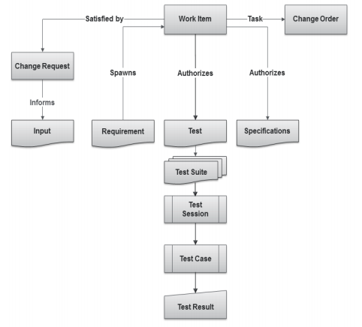
What Are Items?
  Items are the basic building blocks of the Integrity data model, and represent the information assets and process objects associated with software development.
  For example, items can represent Work items, projects, requirements, test cases, change requests, and defects.
  Every item is configurable and contains metadata and history about that item.
  Every item type has its own enforceable workflow which describes how it moves from state to state, complete with definable rules, full audit trails, and security.
  Escalations, conditional assignments, notifications, and external processes can all be defined and initiated as part of Integrity’s process automation

Slide 5
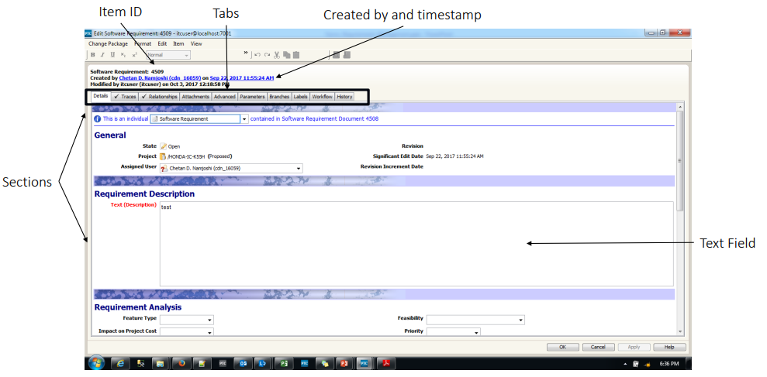
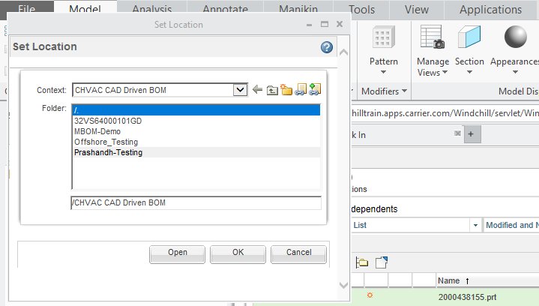
Item Details view
1
2
3
4
5
6

Slide 6
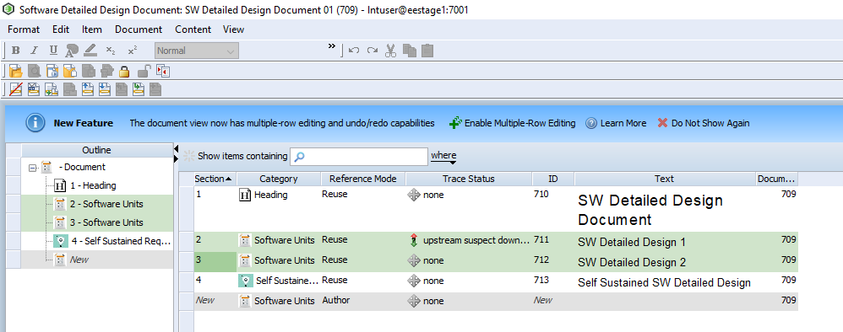
What Is a Document?
Documents are typically used in the requirements management and test management domains.
With the applicable permissions, you can manage all aspects of document and content creation and modification, including creating relationships between content items across and between domains, called trace relationships.
For example, a requirement item could be verified by a test case and that requirement and test case pair could be connected to a larger test suite document using a relationship that collectively verifies a major software change.
The Document view is the interface you use to view
and modify documents and content in a cohesive
tree structure.

Slide 7
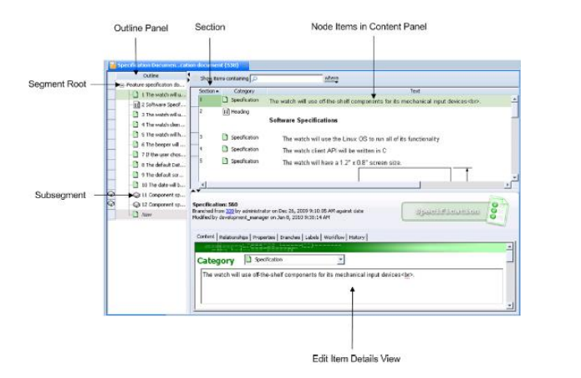
Document View

Slide 8
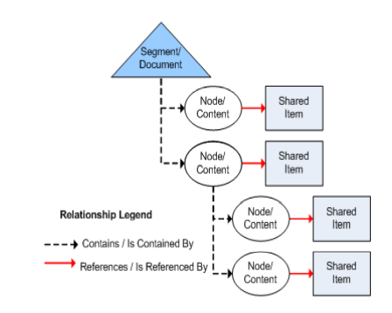
Document Structure
Segment is a root document, the container for all content.
Node is any content within that root document including individual content items and sub-segments
Shared item is the shared content.
A Grouped Hierarchy of nodes in a document, for example: section 1.4 and its children, 1.4.1, 1.4.2 or section 3.4.2 and its children 3.4.2.1, 3.4.2.2.

Slide 9
Finding Documents or Items

Slide 10
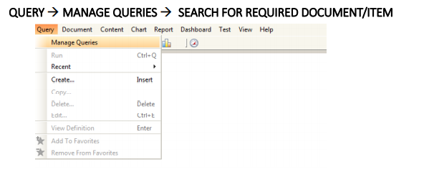
Finding Documents or Items
In order to make it easy for the users, Integrity Client has the functionality to search for documents and Items with the help of query option.
To find any document or item, follow the below steps:
Open Integrity Client.
Select Query in the menu..
In the drop down, select “Manage Queries”.

Slide 11
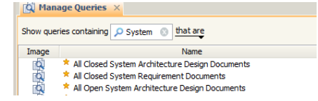
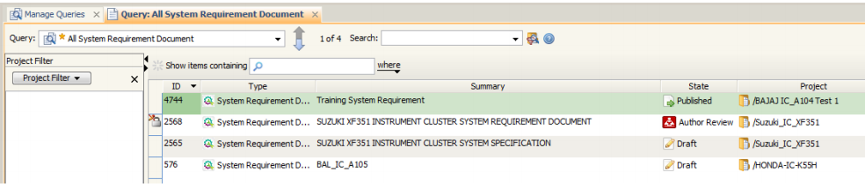
Finding Documents or Items
Selecting Manage Queries will display a list of queries that will assist user in finding the documents based on types and other factors.
For example, if the user wants to look for a System Requirements Document, he/she can search for it using the search bar.
Select “All System Requirement Document” query in order to open the list of System Requirements Documents.
From the displayed list of documents, select the necessary document.

Slide 12

Finding Documents or Items
Integrity also provides an option wherein user can directly search for the Document/Item using its unique ID.
As Item ID for every created content is unique, the search will thus open the required document/item seamlessly.
To search the Document/Item using its Unique Item ID,
Go to the toolbar below menu.
In the search bar with the title as “Item”, type your Item ID and press Enter.
The Document/Item will be displayed.

Slide 13
Baseline
A Baseline is a special label that can only be added to documents. You create a document baseline to mark an important project milestone. For example, you could create document baselines for an approved design document, a legal reference document, a contract, or a bill of materials. You can use document baselines for internal records and for recording external documents.
To create the baseline, you select the individual documents that are required to represent the information for your milestone. When you baseline, Integrity creates a baseline label on each of the selected documents. Each label contains the same timestamp.
Note:
Generally, a label may be any alphanumeric string without control characters.
Labels may also include spaces and punctuation. If versioning is enabled for ▪ the type, the label may not use the same syntax that is used for the version ▪ identifier (that is, major.minor).

Slide 14
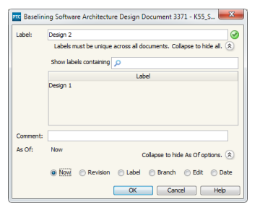
Baselining a Document
1. For the document you want to baseline, do one of the following:
• Open the document in the Document view.
• Select the document from an applicable view or field, for example, the Items view or a relationship field.
2. Select Document ▶ Baseline. The Baseline dialog box displays.
3. Type the name of the Label for the baseline, for example, Design 2. The specified label name must be unique (not already used for the Selected document). If the label name already exists, a red X icon displays and the name must be changed before you can complete the baseline. A green check mark icon displays when a unique label name is specified
TIP:
To make it easier to find a unique label name,
click the Expand to view all button to display a list of existing
label names as shown.
Contd..

Slide 15
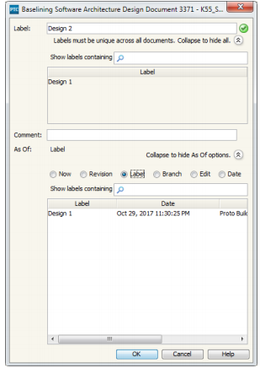
Baselining a Document
4. Select the applicable As Of option from the list. The default option is Now, indicating the current date and time. If you are baselining a historical item, the associated date and time displays by default in the As Of field.
Further, As Of field will have the following options: ₋
-Now – Current Time and Date
-Revision – List of revisions of the document
₋Label – List of labels (Baselines) of the document
₋Branch – List of branches of the document
₋Edit – History of all the edits with modified timestamp
₋Date – Calendar to select date of the document
Contd..

Slide 16
As Of options for Baselining a Document
To baseline a document As Of... | Do this...
Now | Select Now to baseline the current version of the document
Revision | This option is only available if you are baselining a document that allows versioning. Select Revision. A list of all the labels associated with revisions displays. The labels use the format major. minor. Select the revision that corresponds to the time you want to create the baseline as of.
Label | Select Label. A list of all the labels on the document displays. Select the label that corresponds to the time you want to create the baseline as of.
Branch | Select Branch. A list of all the branches associated with the document displays. Select the branch that corresponds to the time you want to create the baseline as of.
Edit | Select Edit. A list of all the dates at which the document item was significantly modified displays. Select the date that corresponds to the time you want to baseline as of.
Date | Select Date. This option allows you to select an arbitrary date for the baseline using the calendar, select the date that corresponds.

Slide 17
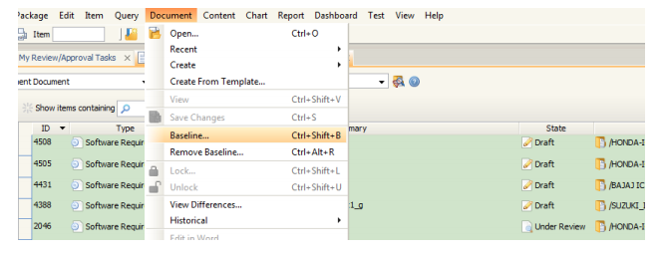
Baseline multiple documents
For the documents you want to baseline, select the documents from an applicable view or field, for example, the Items view or a relationship field
Select Document ▶ Baseline. The Baseline dialog box displays.
Type the name of the Label for the baseline, for example, Project ABC System.
Contd..

Slide 18
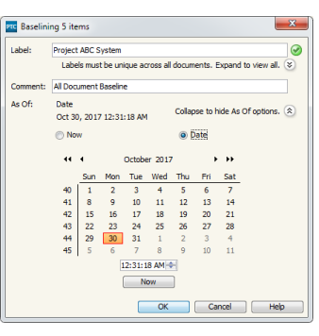
Baseline multiple documents
Select the applicable As Of option from the list. The default option is Now, indicating the current date and time
To baseline a document As Of... | Do this...
Now | Select Now to baseline the current version of the document.
Date | Select Date. This option allows you to select an arbitrary date for the baseline using the calendar, select the date that corresponds. Note: The date selected must not precede the most recent created date of the selected documents.
Contd..

Slide 19
Removing Baselines From Documents
A baseline is a special label added to documents that captures a meaningful point in the document’s history. Typically, PTC does not recommend removing a baseline; however, you may want to remove a document baseline if you want the baseline label to refer to a new date and time.
To remove a baseline, select the documents containing the baseline you want to remove. If you select more than one document, you can only remove baselines that are common to all the selected documents. This means that only baseline labels containing the same name across all the selected documents can be removed at once.
Key Considerations
  Your Integrity administrator determines who can create baselines by configuring the rules associated with removing labels on your document type.
  If you specify a node in the remove baseline operation, the operation is applied to the document that node is contained in.
Contd..

Slide 20
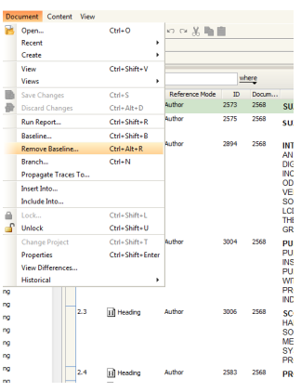
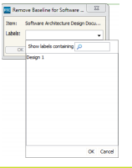
To remove a baseline from a document
For the document you want to remove a baseline from, do one of the following:
  Open the document in the Document view.
  Select the document from an applicable view or field, for example, the Items view or a relationship field.
Select Document ▶ Remove Baseline.
The Remove Baseline dialog box displays.
From the Labels list, select the name of
the baseline label you want to remove.
Only labels associated with a baseline are
available for selection.
Click OK.
Contd..

Slide 21
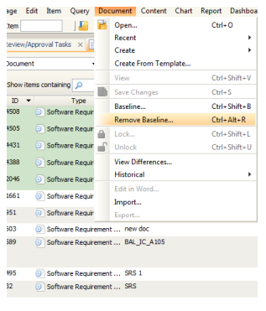
To remove a baseline from all document
For the documents containing the baseline you want to remove, select the documents from an applicable view or field, for example, the Items view or a relationship field.
Select Document ▶ Remove Baseline. The Remove Baselines dialog box displays.
From the Labels list, select the name of the
baseline label you want to remove. Only
labels containing the same name across
all selected documents are available for
selection.
Click OK.
Contd..

Slide 22
Comparing Documents
Compare content and field-level differences between two document selections using the Document Difference view.
For example, user can select a requirements document with two baseline labels and relevant fields of interest to see how the document has changed over time.
The view presents structural and content changes side-by-side in two document panes. Item and field additions, deletions, moves, changes, as well as text differences are highlighted.
User can use navigation tools to efficiently review and navigate the document differences

Slide 23
Key Considerations for Field Selections
The primary text field is always compared.
You can only compare content fields that are relevant to the content type for the selected document type. Supported field types for comparison include the following types: long text, rich text, short text, Picklist, attachment, category, trace relationship, integer, floating point, state, logical, date, FVA to long text, FVA to rich text, FVA to short text, FVA to picklist, FVA to attachment, FVA to integer, FVA to floating point, FVA to logical, and FVA to date. Unsupported field types may contain differences; however, the document comparison algorithm ignores differences in unsupported field types.
Except for the text field, any field you do not choose to compare may contain differences; however the document comparison algorithm ignores differences in fields that are left out of the document comparison.

Slide 24
Selecting Documents to Compare
  You can specify the following types of document selections:
    One document at two different points in time.
    Two versions of the same document (and optionally at different points in time).
    Two branched documents that share a common branch ancestor item ID (and ▪ optionally at different points in time). For example, you can compare a versioned document to a document that was branched.
  To access the Document Difference view in the GUI, select Document ▶ View Differences.
  The steps for comparing documents includes the following steps:
    Select documents to compare.
    Select fields to compare.
    Filter comparison results in the view
    Review document differences.

Slide 25
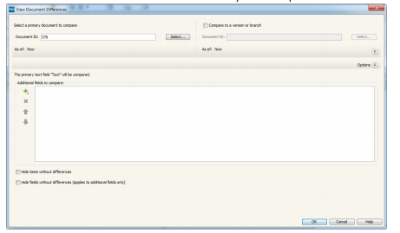
Selecting Documents to Compare
Selecting Fields to Compare
Expand Options and select the content fields you want to compare:
  specifies fields to add to the Additional fields to compare list. You can filter the list of fields.
  removes selected fields from the Additional fields to compare list.
  adjusts the order in which the fields display in the Document Difference view.
Click OK. Your field selections are remembered the next time you compare documents of the same document type.
Contd..

Slide 26

Types of Document Differences
Type of Document Difference | Highlight/ Connector Arrow Color | Interface Icon
Added content An item that is not present in the source document but is present in the target document. A placeholder offers a visual indication of where the addition was made in the source document | Green

Slide 27
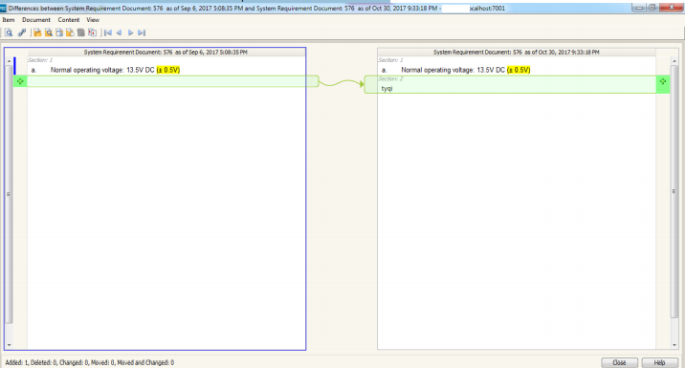
View Differences – Comparison Indicators
Green Link indicates new content has been added compared to first document.

Slide 28
Types of Document Differences
Type of Document Difference | Highlight/ Connector Arrow Color | Interface Icon
Deleted content An item that is present in the source document but is not present in the target document. A placeholder offers a visual indication of where the deletion was made in the target document. | Red

Slide 29
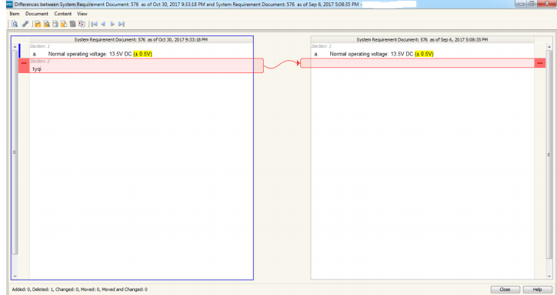
View Differences – Comparison Indicators
  Red Link indicates content is missing compared to first document.

Slide 30

Types of Document Differences
Type of Document Difference | Highlight/ Connector Arrow Color | Interface Icon
Modified content Any non-structural change to item or field content. | Yellow

Slide 31
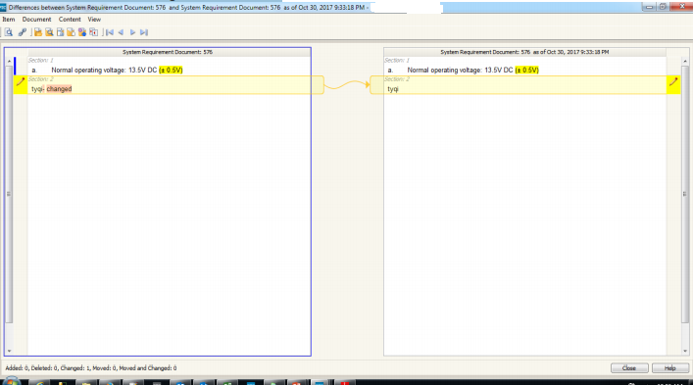
View Differences – Comparison Indicators
  Yellow Link indicates that text has been changed since last edit.

Slide 32


Types of Document Differences
Type of Document Difference | Highlight/ Connector Arrow Color | Interface Icon
Moved content An item present in both the source document and target document that: has a different parent has the same parent but is in a different relative position has a parent that has been moved. | Blue
Moved and modified content | Blue and Pencil

Slide 33
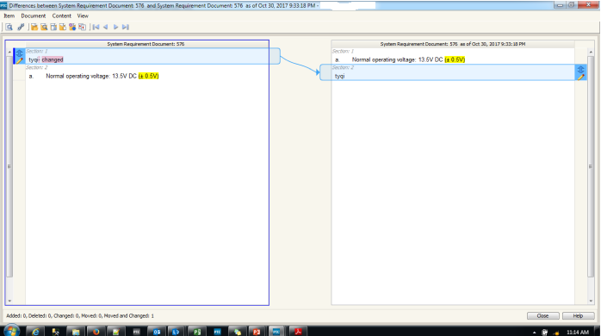
View Differences – Comparison Indicators
  Blue Link indicates that content has been moved.

Slide 34
Navigating Document Difference
You can navigate incrementally through each difference in the current document pane using View menu options, or by using the following toolbar or shortcut key options:
  Previous difference: or press F7
  Next difference: or press F8
  First difference: or press CTRL+F7
  Last difference: or press CTRL+F8
Select View ▶ Wrap Difference Search to configure the Previous and Next difference search options to wrap to the top or bottom of the document pane.
Clear the Wrap Difference Search option to stop at the beginning or end of the document pane.

Slide 35
Navigating the Document Pane
The following document pane keyboard navigation options are available in the Document Difference view for the current document pane.
CTRL+TAB | Switches the focus to the other document pane.
TAB | Selects the next field.
UP arrow key | Selects the previous row header.
DOWN arrow key | Selects the next row header.
HOME | Selects the first row header.
END | Selects the last row header
SPACEBAR | Selects the row header icon in focus and moves to the corresponding difference in the other document pane.
PAGE UP | Scrolls up approximately one page.
PAGE DOWN | Scrolls down approximately one page.

Slide 36
Creating a new Project

Slide 37
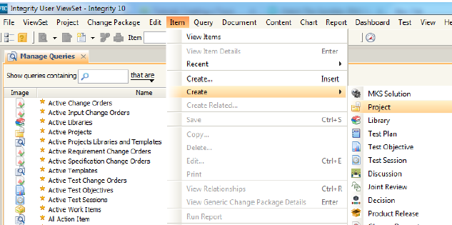
Creating a new project
To create a new project in Integrity, follow the steps given:
  Open Integrity Client.
  Click on “Item” and select “Create” option.

Slide 38
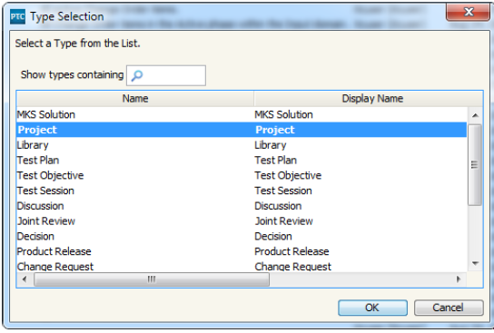
Creating a new project
There will be two create options in the “Item” menu. Both of them display same options.
Between the two create options, any one can be selected.
From the list of options in create, select “Project” option.

Slide 39
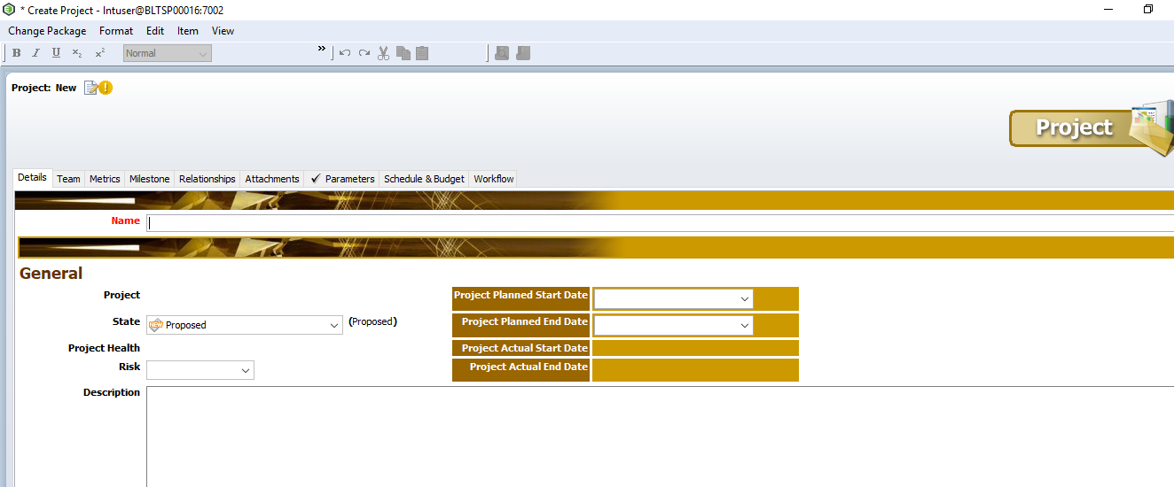
Project Item
After clicking on Project, a window will appear on screen which is called the “Project Item”.
Project Item will contain list of fields that must be filled in order to create a project with appropriate information.
Following is the project creation window with all the fields:

Slide 40

Project Item – Details tab
Details Tab is divided into section; namely:
  Name
  General
  Project Details
Name Section:
  According to the naming convention, Name of the Project must given based on some set of set rule.
  The syntax for entering a project name is as follows:
CustomerName_ProductCategoryAcronymn_ProjectCode
Notice that underscore ( _ ) is used between the names to separate instead of spaces. Check the example below:
Here, Customer Name: HONDA ; Product Category: Instrument Cluster (IC) ; Project Code: K55H.

Slide 41
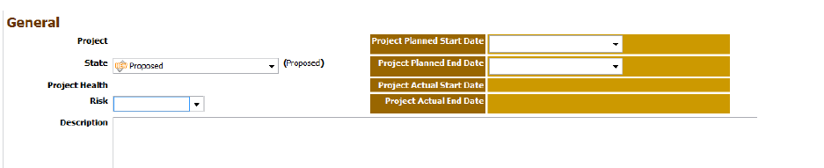
Project Item – Details tab
General Section:
Project -The field project will be auto-populated with the name of the project the user enters after the project item is saved.
State -Based on the maturity of the project, the state of the project can be transited accordingly.
Project Health –Health of the project will be auto-calculated based on various factors that include Budget & Efforts.
Risk -Project Manager can select risk of the project as Low, Medium, High and Critical.
Planned Start Date –The planned start date of the project.
Planned End Date –The planned end date of the project.
Description–Explanation regarding the project.

Slide 42
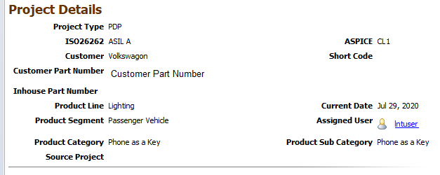
Project Item – Details tab
Project Details Section:
Customer: Name of Customer
Customer Part Number: Unique Part number
Inhouse Part Number: Varroc Internal Part Number
Functionality: Select functionality of the project
Product Category: Product of which the project is undertaken
Product Sub Category: Sub category of product
Assigned User: Responsible person for project management
Source Project: Related SCCM project .

Slide 43
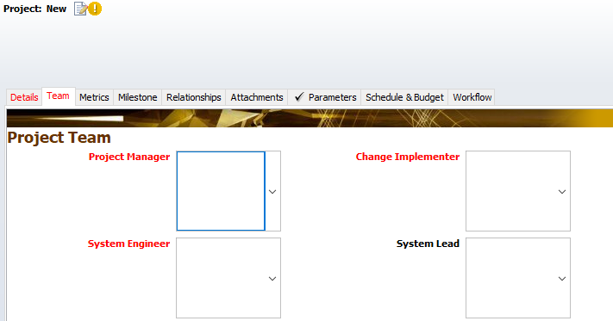
Project Item – Teams tab
Team tab enables Project managers to enter team members related to project with respect to the roles of the users for the project.
In each of the fields, Managers can select users from the list of users in the system.
Managers must ensure that they enter correct names according to the role of the project responsibilities.
Mandatory Fields: (Although all fields are not mandatory initially, Mangers are recommended to enter all users by roles).
Project Manager Testing and Validation Engineer
Change Implementer Quality Engineer
System Engineer
.

Slide 44
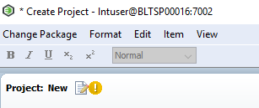
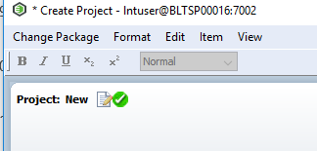

Saving Project Item and Creation
Once the basic and initial mandatory fields are completed, user can notice that a bright green symbol on the left hand top corner of the screen is displayed indicating that the user can now save his/her project.
Before filling mandatory fields After filling mandatory fields
Clicking Apply will create a project in the system.
Notice that Project field is auto-populated with the name entered in Name field once project is created. The Project is created with a ‘/’ (Forward Slash) which is the Integrity Configuration convention.
If this field is empty after the user saves this project, then the user has entered the name of the project wrongly without following the nomenclature(Naming Convention). In such case, user must create another project item.

Slide 45
Defining the Project
Even though the project is created, Managers are recommended to Mature the project further to “Defined” state.
This is included in the project creation as defining a project will help explain significance of the project in much more detail.
Steps to Mature project to Defined state:
Go to Details Tab of the Project Item.
Select state as “Defined”. Some fields will become mandatory and will be marked as Red.
Ensure all Project Details are filled.
Go to Milestonetab. Here Manager needs to enter the milestones for the project with all the dates and deliverable details related to the milestones.

Slide 46
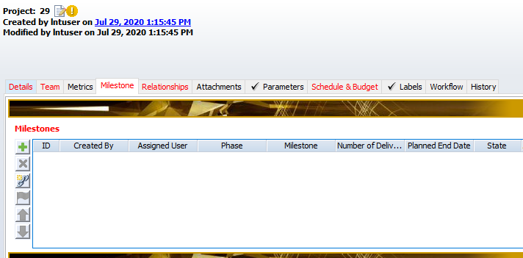
Project Item –Milestone Tab
To make the project “Defined”, Milestones need to added to Project Item in Milestones Tab.
Milestones become mandatory when user tries to make transition from Proposed to Defined state.

Slide 47
Project Item –Relationships Tab
Relationship fields:
Documented By: All Project related documents will be auto-populated here.
Strategies: All Project related Strategies will be auto-populated here.
Test Plans: All Project related Test Plans will be auto-populated here.
Product Release Plans: All Project related Product Release Plans will be auto-populated here.
Change Requests: All Change Requests related to project will be auto-populated here.
Parent Of/ Child Of: It mentions parent or child project if any such hierarchy is followed in the system.
Work Items: All work items related to project are displayed here.
Defects: All defects related to project are displayed here.
Risk Analysis Report: Manager needs to create a risk analysis report before the project state is made defined.
All the remaining objects related to projects will be available in Relationship tab and it will display all related objects for the project.

Slide 48
Defining the Project
•Once all mandatory fields for are filled completely, the Project Manager can successfully change his/her project to “Defined” state.
•Changing the state to Defined is only possible if Risk Analysis Document is attached in the Relationship tab.
•All mandatory fields including Milestones and other information must be filled to successfully save the Project.

Slide 49
Creating Risk Analysis Document
(Create a Document)

Slide 50
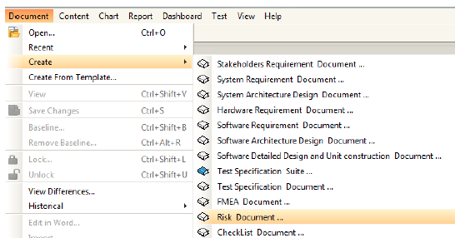
Creating and Managing Documents
Select Create Document menu to create a new document in Integrity.
Steps:
1.Creating Risk Analysis document
2.Select Appropriate Project
3.Editing data in Item view
4.Applying changes in created document
5.Document view
6.Creating/Editing contents

Slide 51
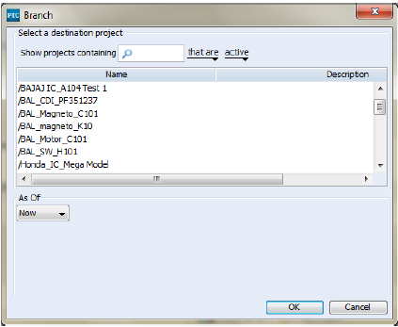
Creating and Managing Documents
Select a project under which document needs to be created then Click “OK” button.
Steps:
1.Creating Risk Analysis document
2.Select Appropriate Project
3.Editing data in Item view
4.Applying changes in created document
5.Document view
6.Creating/Editing contents

Slide 52
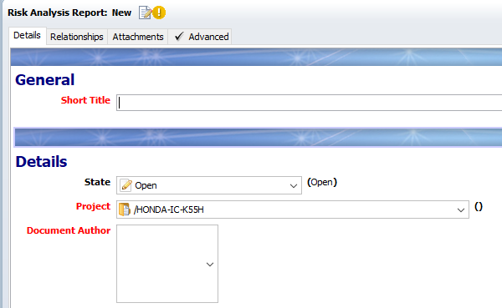
Creating and Managing Documents
Document item view will open up. Enter or select correct values for the fields present. Project field will be populated as per selection in step 2.
Steps:
1.Creating Risk Analysis document
2.Select Appropriate Project
3.Editing data in Item view
4.Applying changes in created document
5.Document view
6.Creating/Editing contents
Field marked red are mandatory fields and must be filled.

Slide 53
Creating and Managing Documents
All other fields visible in the Document Item view must be filled.
Fields that are not editable will be editable depending on the state of the document it is in.
Clicking on “Apply” will keep the user on the same screen while clicking on “OK” will open the document view window.
Clicking “Apply” will save the document. Alternately “Ctrl + S” can also be used.
After all fields are filled, Click “OK” button to create the document.
Steps:
1.Creating Risk Analysis document
2.Select Appropriate Project
3.Editing data in Item view
4.Applying changes in created document
5.Document view
6.Creating/Editing contents

Slide 54
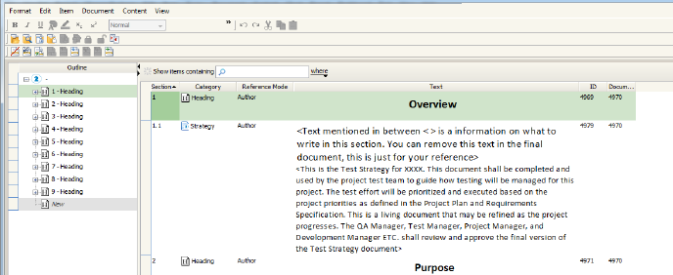
Creating and Managing Documents
As soon as you click “OK” in item view, you will be navigated to “Document View Window”.
Steps:
1.Creating Risk Analysis document
2.Select Appropriate Project
3.Editing data in Item view
4.Applying changes in created document
5.Document view
6.Creating/Editing contents
If the document is newly created, the user must populate it with content in the line items provided.

Slide 55
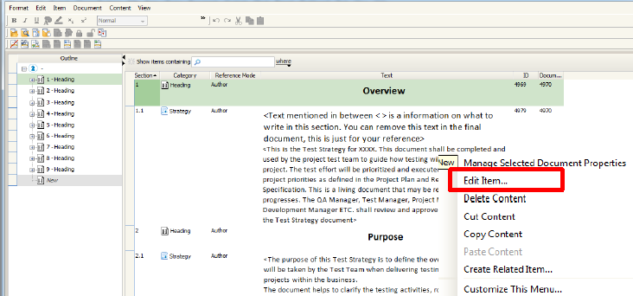
Creating and Managing Documents
User can create content by clicking on the line item and type the title in the text and then right click on it and select “Edit Item”. Fill required details. Click on “OK”.
Steps:
1.Creating Risk Analysis document
2.Select Appropriate Project
3.Editing data in Item view
4.Applying changes in created document
5.Document view
6.Creating/Editing contents

Slide 56
Risk Analysis Document –Details Tab
The Details tab contains the following Sections:
General Section:
  Short Title: Short Title for Risk Analysis Document
Details Section:
  Project: Project for which the Product Release Plan will take place
  Document Author: User responsible for the Risk
  Assigned Reviewer: User responsible to monitor and examine the Risk Document
  State: State of the item based on workflow. (Default state selected will be “Open”)
  Comments: Reviewer must enter comments in this field before closing the document.

Slide 57
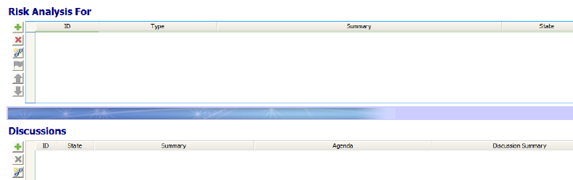
Risk Analysis Document –Relationships Tab
Relationship tab contains the following relations of Risk Analysis Document:
₋Documents–Contains Name of Project
₋Discussions–Related Discussion items are attached here
₋Risk Analysis for –User can attach related object which is project for which the Risk Analysis is carried out.

Slide 58
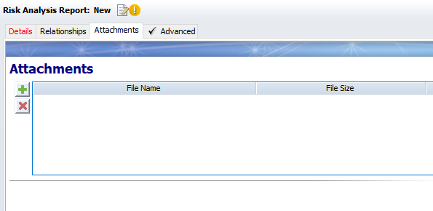
Risk Analysis Document–Attachments Tab
Attachment tab avails users to add project/document related files to the Risk Analysis Document:
Note: Attachments can be of any file format. It should not exceed the size of 5MB.

Slide 59
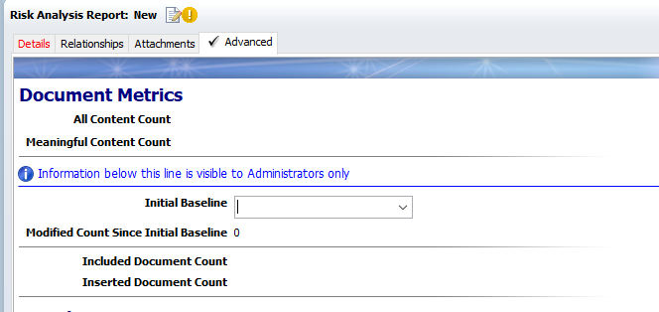
Risk Analysis Document–Advanced Tab
Advanced tab contains Document Metrics that describes the Requirement Document:
₋Document Metrics
•All Content Count-The number of content items in this segment.
•Meaningful Content Count -The number of meaningful items in this segment.

Slide 60
Integration with Microsoft Project

Slide 61
Creating Microsoft Project Plan
In order to increase work efficiency and manage all activities related to project better, Managers make use of Microsoft Project to make plans and assign activities to resources conforming to the dates of the projects and other deadlines.
Similar activities are also created in Integrity known as “Work Items”.
In order to save time of creating these activities again in Integrity, the magic of integration has been introduced to Project Management Project.

Slide 62
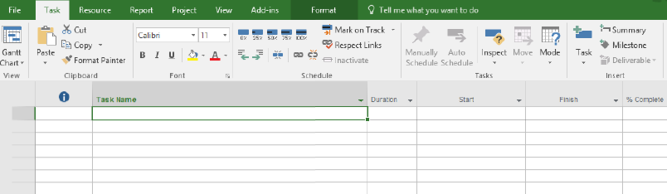
Creating Microsoft Project Plan
Given below is the Microsoft Project Plan Template where the plan needs to be made.
Task Name: Name of Activity
Start: Project Start Date
Finish: Project End Date
MKS Risk: Project Risk
[Low, Medium, High, Critical]
MKS State: Activity state based on workflow
Resource Name: Activity assigned to
MKS Issue Type: Always keep Work Item
MKS Issue: Generated Unique ID in Integrity
Integrity Project: Project Name in Integrity
Actual Completion Date:
Date when Activity is completed in Integrity
Note: Fields marked in Red are mandatory fields. Activities will not sync if these fields are not entered or filled incorrectly.
.

Slide 63
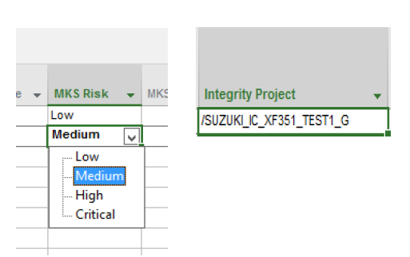
Creating Microsoft Project Plan
Based on the descriptions of the columns, populate the Project template to make a project plan.
The window will be as follows:
MKS Risk column will have a drop down to select from.
Name of the project will have a “/” at the Beginning of the Project name (This is a mandatory step).

Slide 64
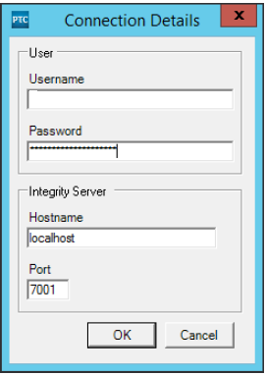
Synchronizing Microsoft Project Plan Resources
Project Integration has the ability to sync resources with PTC integrity in order to assign resources for the task in MS Project itself.
In order to sync resources follow the below steps:
  Go to Add-ins.
  Click on PTC integrity Menu.
  Click on “Synchronize Resources”.
  An authentication window will appear wherein the user must enter his/her
  credentials and validate himself/herself as a valid user.
  Enter username and password. Enter appropriate Hostname(Test Server IP) and Port.
  Click on “OK”.

Slide 65
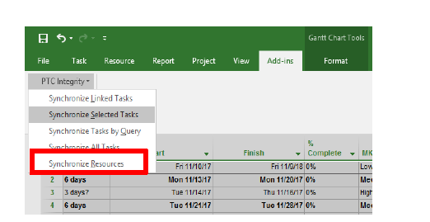
Synchronizing Microsoft Project Plan Resources
Click on Resource Names column to check all synced resources.
Assign resources to the activities based current role in the project.
Resource that is assigned to the activity must be a part of the Project entered in the field “Integrity Project”.
(Resource entered must be a part of Team in Project created in Integrity)

Slide 66
Synchronizing Microsoft Project Plan Resources
Once all fields are entered and the plan is ready, the user is ready to push all activities(Work Items) into PTC Integrity.
This activity involves selecting all or particular tasks and syncing the tasks.
To push or automatically make work items in Integrity, follow the procedure given below:
  Select the activities that are to be pushed to Integrity.
  Go to Add-ins.
  Click on PTC integrity Menu.
  Click on “Synchronize Selected Tasks”.
  An authentication window will appear wherein the user must enter his/her credentials
  and validate himself/herself as a valid user.
  Enter username and password. Enter appropriate Hostname(Test Server IP)
  and Port.
  Click on “OK”.

Slide 67

Synchronizing Microsoft Project Plan Resources
After clicking on “OK”, all or selected work items will start synchronizing to PTC Integrity.
After the sync is successful, a symbol will appear besides the activities that are synchronized.
It indicates that the work items corresponding to the activities in MS Project have been successfully created in Integrity.

Slide 68
Looking for created Work items in Integrity
To view the work items created for the project through MS Project, the user may login to PTC Integrity.
Steps to view work items in Integrity:
  Login to PTC Integrity.
  Go to “Query” menu.
  Select “Manage Queries”.
  In the search bar, type “All Work Items”. Double click on it to open.

Slide 69
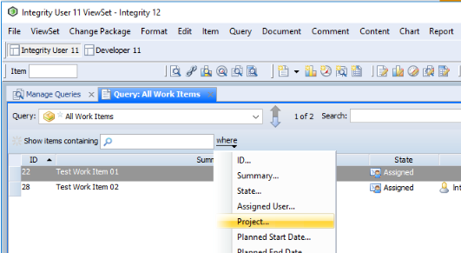
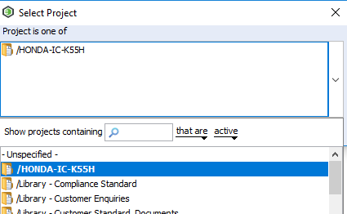
Looking for created Work items in Integrity
After you click on “All Work Items”, a list of work items will be
displayed.
In order to sort the work items based on a particular project:
Click on “where” filter. Located below Query bar.
From the list of options select “Project” as shown.
A window will appear. Click on the dropdown button.
From the list of all project search and select required
Project by double clicking.
Click on “OK”.
List of Work Items will appear that are related to the
selected project as shown below.

Slide 70
Monitoring Activities in Project

Slide 71
Synchronizing Microsoft Project Plan Resources
After the initial task of pushing work items in Integrity,
the following task on Managers is to closely monitor the project.
This can be done by monitoring all the work items in Project itself.
  To monitor the work items, do the following steps:
  Select the work items whose status (State) needs to be
  monitored.
  Go to Add-ins.
  Click on PTC integrity Menu.
  Click on “Synchronize Selected Tasks”.
Notice the change of states in the work items selected.

Slide 72
Creating a Work Item(Create an Item in Integrity)

Slide 73
Roles & Responsibility
ROLES | RESPONSIBILITIES
Created By | Created by is the user who creates the Action Item in system. Anybody can create the Action Item
Assigned User | Assigned user is the person who works on the given action item.
Assigned Reviewer | Assigned Reviewer is the person who reviews the given action item.

Slide 74
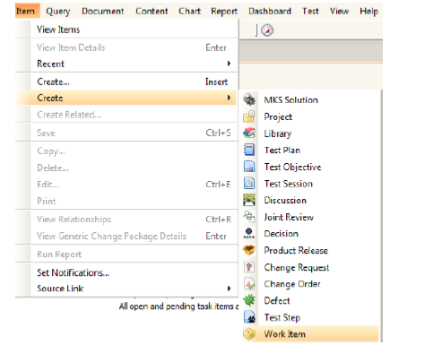
Creating and Managing Action Item
Select Create Item menu to create a new item in Integrity.
From Create item, select Work Item.
Steps:
1.Creating Work Item
2.Editing data in Item view
3.Applying changes in created document

Slide 75
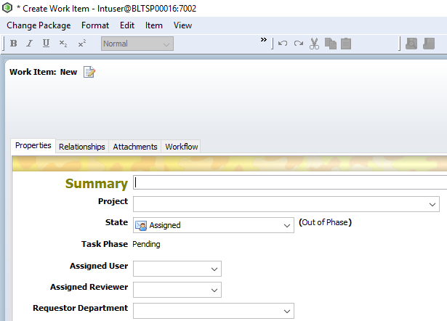
Creating and Managing Action Item
After selecting Work Item , item detail view will open up.
Enter or select correct values for the fields present.
Fields like Summary, Project and Assigned User marked red are mandatory fields and must be filled during creation.
Select appropriate field values (one or multiple) for multi-select fields (if any).
Steps:
1.Creating Work Item
2.Editing data in Item view
3.Applying changes in created document

Slide 76
Creating and Managing Action Item
All other fields visible in the Item view must be filled.
Field edit ability depends upon Action Item workflow LC state, depending on the state of the item it is in. Fields become editable or non editable
Clicking on “Apply” will keep the user on item edit view (user can still update fields) while clicking on “OK” will open item non-editable view (user can not update item fields)
Clicking “Apply” will save the Item. Alternately “Ctrl + S” can also be used.
Steps:
1.Creating Work Item
2.Editing data in Item view
3.Applying changes in created document

Slide 77
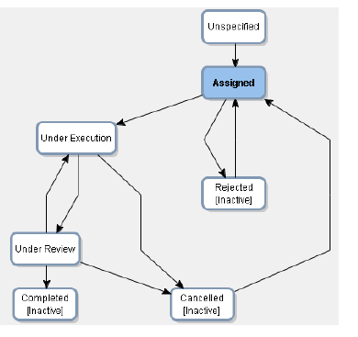
Work Item Workflow
Work Item Workflow describes its state transition from one state to next state based on completion of activities as per system designed.
Refer below workflow diagram for working in Work Item in PTC Integrity system.

Slide 78
Different Tabs in Work Item
TAB NAME | TAB USED FOR
Details | Details contain all the necessary information, which need to be filled by different users on different stage to work on a action item.
Relationships | Relationship Tab contains all the related item/documents of action item.
Attachment | In attachment tab, user can attach external document like word/pdf/excel etc.
Workflow | Workflow tab contains action item workflow.
History | History tab records all changes done by any user anywhere in action item.

Slide 79
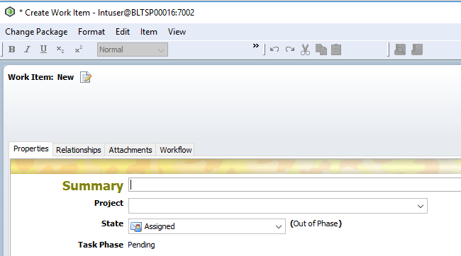
Details Tab Explained: General (Section 1)
In Details tab, Summary section contain the basic information of Work Item.
General section contain fields like Summary, State, Project, Requestor Department, Receiver Department, Risk, Planned Start Date, Planned End Date.

Slide 80
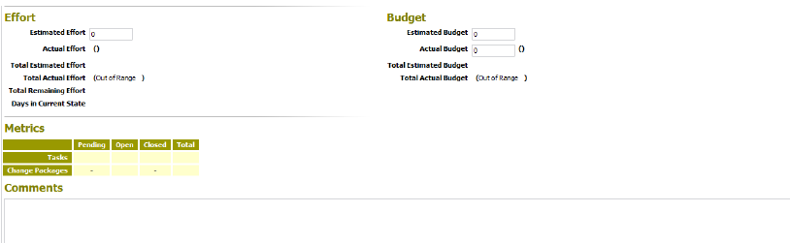
Other Sections in Properties Tab
Work Items has other sections like Effort, Budget and Metrics.
Effort Section contains Estimated Effort (In Days) field where user has to enter a value in number.
Budget Section contains Estimated Budget and Actual Budget in Rupees that are to be filled by user.
Other all the fields are automatically calculated and populated based on system use and visibility.
Metrics Tab will also be auto populated based on other tasks and Change.
Comments field will be mandatory before the Work Item is either “Completed” or “Cancelled”.

Slide 81

Relationships Tab
The item for which the Work Item is created should be attached in “Work Item For” relationship field.
Related items that can be attached to this field are: Project, Defect and Work Item
Example shown below:

Slide 82

Work Item –Attachments Tab
Attachment tab avails users to add project/document related files to the Work Item:
₋Internal Attachments –Company related attachments
₋Customer Attachments –Related documents given by customers
Note: Attachments can be of any file format. It should not exceed the size of 5MB.

Slide 83
Workflow and Managing Work Item

Slide 84

Work Item Workflow Transition
Primary Actor: Work Item Creator
When creator creates a new Work Item, by default it will be in “Assigned” state.
Only creator can transit the workflow from “Assigned” to “Under Execution” state.
For Under Execution state, Summary, Project, Requestor Department, Receiver Department, Assigned User fields are mandatory which are marked by Red.
If the work item is not workable or activity in the work item gets cancelled by any chance, the work item can be Rejected.

Slide 85
Work Item Workflow Transition
Primary Actor: Work Item Creator
After “Assigned” state, next is “Under Execution” state.
In “Under Execution” state, the assigned user will work on the Work Item taking necessary actions.
Once the task mentioned is done, user must change the state to “Under Review”.

Slide 86
Work Item Workflow Transition
Primary Actor: Work Item Creator
After “Under Execution” state, next transition is “Under Review” state.
In Under Review state, assigned user accepts the work item for review.
In Under Review state, Comments fields becomes mandatory.
Only Assigned Reviewer can transit the workflow from
“Under Review ”to “Completed” state.
Reviewer also has the authority change the state to “Cancelled” if required.
If any changes are required, Assigned Reviewer can change back the state from “Under Review” to “Under Execution”.

Slide 87
Work Item Workflow Transition
Primary Actor: Work Item Creator
Once the Work Item is completed, Actual Completion Date will be populated with the time and date when the user changes and saves the state to “Completed”.

Slide 88
My Assigned Task Query Explanation

Slide 89

My Assigned Task Query Explanation
All action item assigned to some user.
Assigned user can search for his/her assigned action item through “My Assigned Task Query”.
My Assigned Task Query contains all the assigned task of user but here we search for Work Item.
Go to Query -> Manage Query -> Search My Assigned Task -> Where Filter -> Select Work Item

Slide 90

My Assigned Task Query Explanation
In My Assigned Task, all the object assigned to user will be present.
User can filter task based on types/states/etc. as per user requirement.

Slide 91

Thank you
Thank you

